Slide 1
Implement (VQ-VAE) for defect detection in product images.
Presented by:
Satyam Yadav 22BAC10008
Ashutosh Kushwaha 22BAC10022
Shiv Pratap Singh 22BAC10029
Vivek .K. Vishwakarma 22BAC10036
Jay Hepat 22BAC10040
Karan Gandha 22BEC10002

Slide 2
Introduction: Defect Detection with VQ-VAE
Problem:
- Manual visual inspection is slow, inconsistent, and labor-intensive.
- Prone to human error and fatigue, especially in high-volume
manufacturing
We propose using VQ-VAE (Vector Quantized Variational Autoencoder), which learns to reconstruct normal, defect-free images in an unsupervised manner. During testing, anomalies are detected by identifying areas with high reconstruction errors, indicating deviations from learned normal patterns.

Slide 3
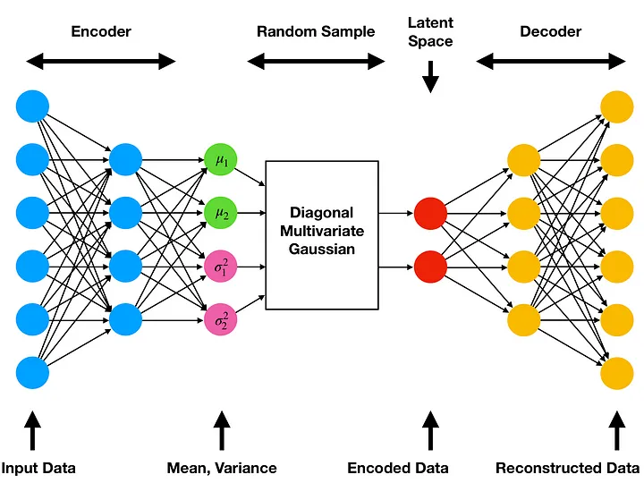

Slide 4

Data set and Preprocessing
Dataset: MVTec Anomaly Detection
-6 Product Categories: Bottle, Capsule, Grid, Metal Nut, Pill, Transistor.
Data Characteristics:
-High-resolution industrial images with labeled defects & ground truth
masks.
-Images resized to 256 × 256 for uniform input.
Preprocessing Steps:
-Normalized pixel values to [0, 1].
-Defect masks resized using nearest-neighbor interpolation.
Training Configuration:
-Batch Size: 16 → Allows stable gradient updates & efficient GPU usage.
-Epochs: 30
-Learning Rate: 0.001
Split:
-Training: Defect-free images.
-Testing: Mix of normal & anomalous samples with masks.

Slide 5
Architecture of VQ-VAE :
Understanding : Encoder, Quantizer, Decoder
Core Idea: Learn a discrete latent representation of normal data.
Encoder: Maps input image to a continuous latent space.
-Convolutional layers, downsampling, ReLU activations.
Quantizer: Maps continuous latent vector to nearest codebook vector.
-Euclidean distance to find the closest codebook vector.
Decoder: Reconstructs the image from the quantized latent vector.
-Deconvolutional layers, upsampling, sigmoid output.
Hyperparameters: Codebook size, embedding dimension, learning rate.
Loss Function: Reconstruction loss + commitment loss + codebook loss.

Slide 6
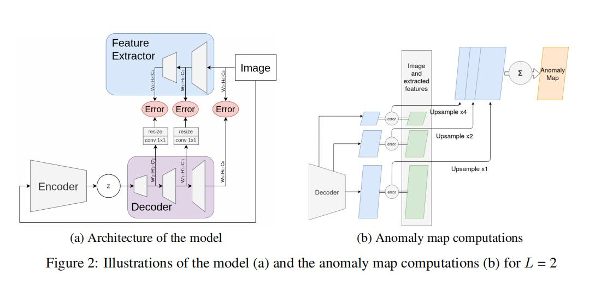

Slide 7
Implementation & Evaluation – VQ-VAE Setup
Framework: we are using PyTorch.
Training Data: Only defect-free images per product class (unsupervised)
Anomaly Detection: Pixel-wise reconstruction error (MSE) used to detect defects.
Anomaly Score: High error = more likely defect.
Visualization: Heatmaps, predicted masks, and overlay for visual inspection.
Note: AUC and F1-Score not yet computed; focus is on qualitative analysis.
“While some implementations evaluate using metrics like AUC or F1-score, our current focus was on visual inspection and qualitative results. These metrics can be added later for a more quantitative evaluation.”

Slide 8
Results, Visualizations, and Interpretation
Reconstruction Error Maps: compare the original image and its VQ-VAE reconstruction using Mean Squared Error (MSE).
Heatmap Visualization: converts the reconstruction error into a normalized heatmap using matplotlib's jet colormap.
Thresholding for Defect Segmentation: Apply a fixed threshold (e.g., > 0.05) on the heatmap to produce binary masks, marking regions as defective.
Interpretation :
Compare GT Mask vs Predicted Mask (Boxes 3 vs 5): For accuracy
Heatmap (Box 4): Visualizes model’s “attention” sensitive .
Overlay (Box 6): Intuitive result for presentations.

Slide 9
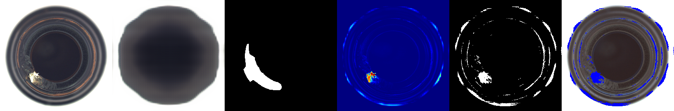
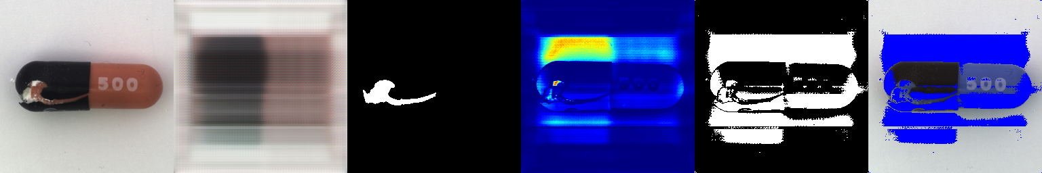
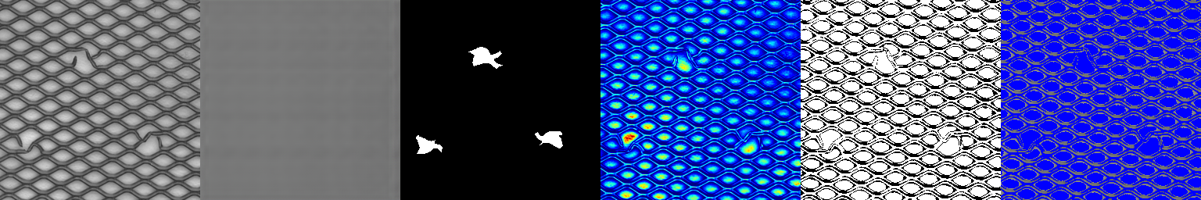
Sample visualizations
Original Image
Reconstructed Image
GT
Mask
Reconstruction Error
Heatmap
Predicted Binary Mask
Overlay on Original
Bottle
capsule
grid

Slide 10
Conclusion
The pipeline is unsupervised, robust, and adaptable to different product types.
Can significantly reduce manual inspection and improve quality control efficiency in industries.
Future Improvements:
-Integrate VQ-VAE-2 for hierarchical latent representations and better
reconstructions.
-Apply attention mechanisms to focus on important features.
-Explore GAN-based models to generate more realistic reconstructions.
Real-time Deployment Ideas:
-Optimize model size for deployment on edge devices.
-Use the system in automated visual inspection pipelines in factories

Slide 11
THANK YOU

